Slide 2
Substance Facilitated
Sexual Assault (SFSA)
What is SFSA?

Slide 3
From the Rape, Abuse & Incest National Network (RAINN)
SFSA is:
  When drugs or alcohol are used to compromise an individual’s ability to consent to sexual activity.
  In addition, drugs and alcohol are often used in order to minimize the resistance and memory of the victim of sexual assault.

Slide 4
Substances May Include…
Alcohol
GHB (Liquid X)
Benzodiazepines (such as Xanax)
Ketamine (Special K)
MDMA (Ecstasy or Molly)
Zolpidem (Ambien)

Slide 5

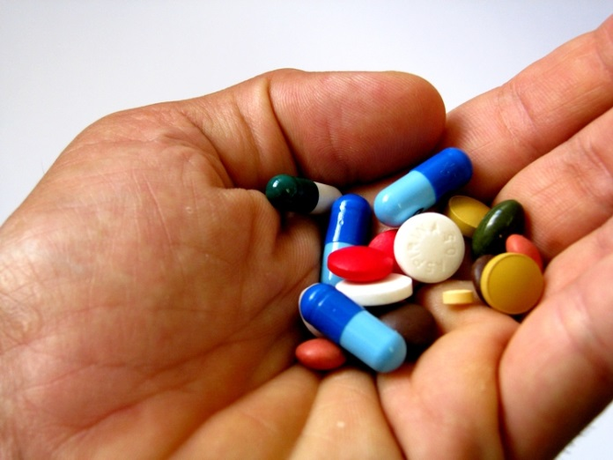
Quiz:
What is the most common substance used by perpetrators for SFSA?

Slide 6
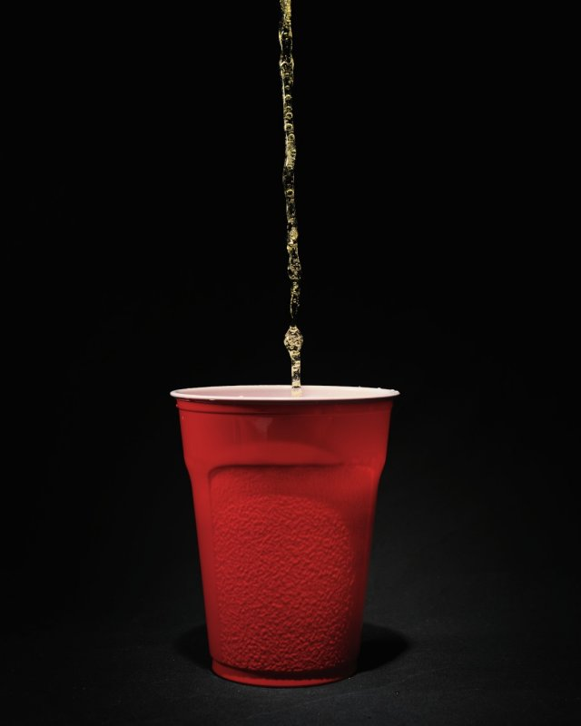
Answer
ALCOHOL
It is estimated that 30%-79% of all sexual assault involves consumption of alcohol.

Slide 7
Did You Know That…
In 1 in 3 sexual assaults, the perpetrator was intoxicated – 30% by alcohol, 4% by other drugs.
75% of the men and 55% of the women involved in acquaintance rapes were drinking or taking drugs before the attack.
Approximately 4 out of 5 rapes were committed by someone known to the victim.
*RAINN (Rape, Abuse & Incest National Network)

Slide 8
South Carolina Laws on SFSA
Consent cannot legally be given by someone who is incapacitated, mentally defective, or physically helpless.

Slide 9
South Carolina Laws on SFSA
A person can receive up to 30 years in prison for sexually assaulting the victim after giving him or her a controlled or intoxicating substance, such as alcohol or a “date rape” drug.

Slide 10
South Carolina Laws on SFSA
A person may receive a sentence of up to 10 years in prison for sexually assaulting a victim despite knowing that the victim is mentally defective, incapacitated, or physically helpless.

Slide 11
Understanding Consent
Consent is a clear, conscious, willing, and affirmative agreement to engage in sexual activity.
A person who is incapacitated for any reason is not capable of giving consent.
Prior consent does not guarantee future consent.
The style of a person’s clothing does not express consent.
Notes:
Shannon - (have this slide up when introducing topic?)
Slides 15-16: 15 minutes
As bar staff, you probably see people drinking and flirting, or arriving with friends and leaving with someone else. As people who could potentially intervene and stop an act of violence from happening, it is important to critically think about the complicated issue of ETOH and sex.
Activity: difference between rape & sex – record on flip chart (2 columns)
Sex: mutual, consensual, fun, intimate
Rape: one-sided, unhealthy display of power, crime, scary

Slide 12
Understanding Consent
Silence or the absence of a “no” does not mean there is consent.
An unconscious person cannot consent.
Consent for one sexual act does not imply consent for other sexual acts.
Consent can be withdrawn at any time.
Consent is not coerced.

Slide 13
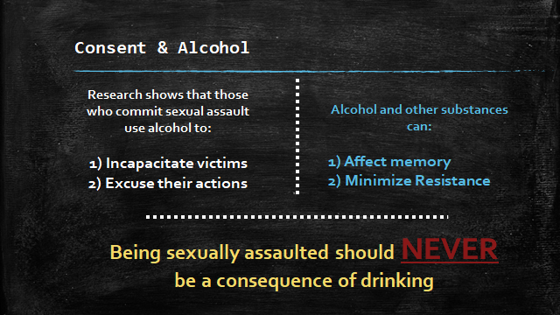
Sexual Assault Is NOT a Consequence of Drinking

Slide 14
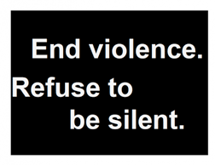
The 5 Steps
of Bystander Intervention
Notice the situation.
Recognize if the situation requires intervention.
Assume personal responsibility for intervening.
Decide the most effective way to help.
Intervene.

Slide 15

Tips for Bar Owners/Bartenders
Check on people who seem uncomfortable.
Have a list of trusted taxi drivers to offer to patrons if needed.
Pay attention if someone becomes extremely intoxicated (especially if only after 1 or 2 drinks).
Notes:
Letting vols know that if staff/managers ask more questions, they can share some ideas. Just remembering to mention the full/more extensive training available. Maybe some of the students have worked in bars, etc. Possible discussion opportunity.

Slide 16
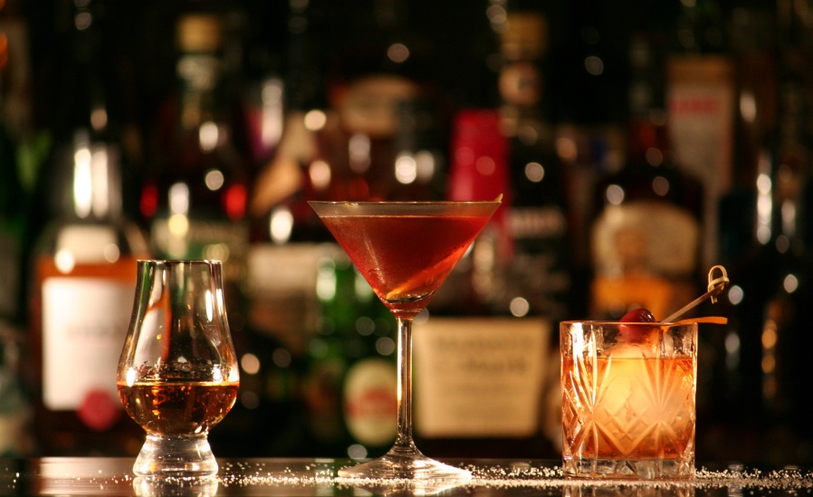
Tips for Bar Owners/Bartenders
  Offer water.
  Ask if they have a friend or designated driver.
  Don’t leave them alone.

Slide 17
Tips for Bar Owners/Bartenders
There are options if you feel uncomfortable confronting the perpetrator or involved parties.
  Call the police.
  Inform managers, co-workers, owners → come up with a plan.
  Inform drink owner.
  Dump drink.
  Hold drugged drinks behind counter.
  Document.
USE YOUR BEST JUDGMENT!

Slide 18
What Are the Benefits of Intervention?
Keeping patrons safe
Good reputation for establishment
It’s the right thing to do.

Slide 19
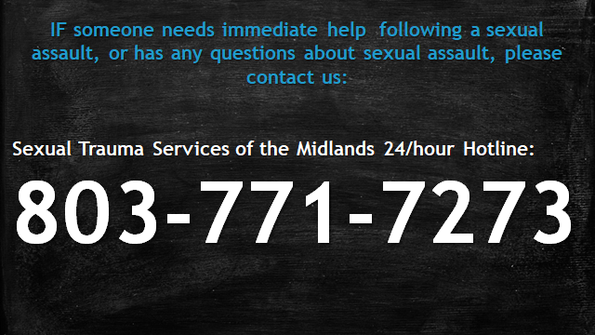
Resources

